Slide 1
Data Advisory Committee
Purpose, Planning, & Formation

Slide 2
Purpose:
Produce consistent reporting.
Reduce the replication of efforts.
Provide a network that will improve communication and establish best practices among all departments reporting sales related data.
Increase quality of data used in decision making by utilizing a validation process.

Slide 3
Data Management Plan:
Description of the data to be collected or created
Standards/methodologies for collection, analysis, and management
GDPR compliance, ethics, and intellectual property considerations
Platform for sharing and accessing data
Strategy for long term preservation
Data request process

Slide 4
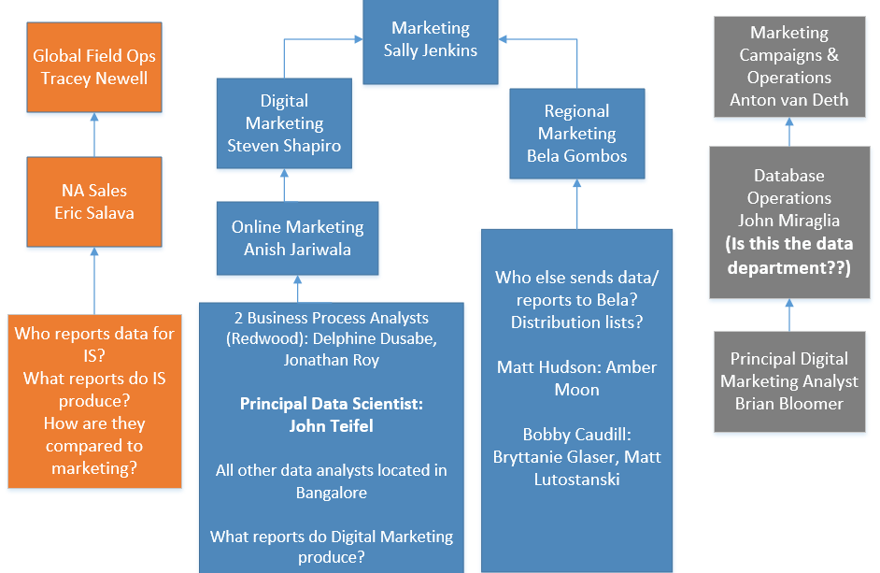

Slide 5
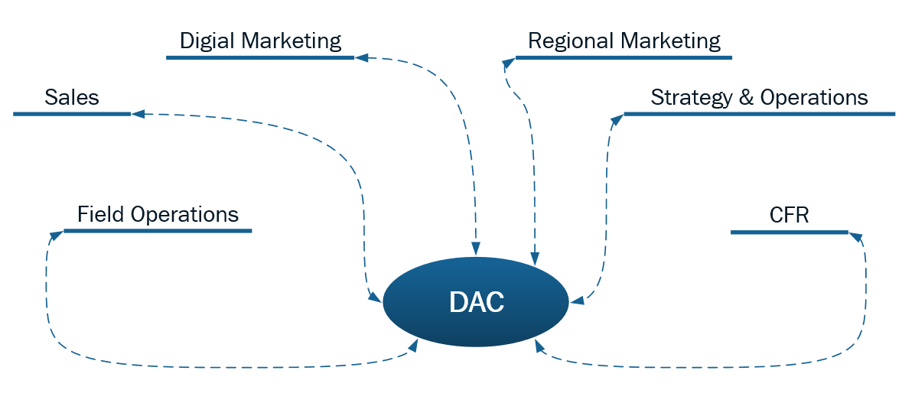

Slide 6
Planning
Short Term (remainder of 2018)
Collaboration between BDM, IS, and CFR teams
Establish reporting structures and guidelines to improve quality of data used to draw correlations pertaining to lead flow and campaign generated revenue
Long Term
Focus on advancing a culture of quality and continuous improvement to accelerate business value and drive growth across all departments

Slide 7
First DAC Meeting:
September
Location, structure, and contents of data library; documentation of glossary/acronyms, universal methodologies, code snippets, SFDC report templates
Consolidation of reports (combine, then reduce) → Data warehouse team formation (?)
Establish streamlined structure for reporting out Q3 results
American Society for Quality Membership
Q4 Meetings
Continue process of combing through and consolidating reports

Slide 8
American Society for Quality (ASQ)
“Regardless of industry, ASQ Organizational Membership encourages the learning and implementation of quality methodologies that ensure a strong supply chain, enhance customer experience and help organizations reach their triple bottom-line goals.”
Austin ASQ Chapter: https://asqaustin.org/
San Francisco ASQ Chapter: http://www.asqsf.org/
Redwood ASQ Chapter: https://sites.google.com/site/asq0617/
Membership: https://asq.org/membership/organization
Certification & Training:

Slide 9
Participants:
Analysts/Anyone else deals strictly with data, or would be invested DAC productivity? If there were a data department who would be in it?
Who else is in Austin?
Christian Lafargue – Sales Analyst – Sales Strategy and Planning
Carlos Zepeta – Sr. Analyst - Strategy and Planning
Mele Bennett – Principal Sales Operations Analyst
Justin Jarus – Principal Sales Operations Analyst
Redwood:
Brian Bloomer – Principal Digital Marketing Analyst
Anton van Deth – VP, Marketing Campaigns and Operations
John Teifel – Principal Data Scientist
Donna Hanvey – Principal Sales Operations Analyst
Beth Roach – Director of Pipeline Management
DuVal Hicks – Sr. Director of Sales, Strategic Execution

